Slide 1
Deterministic and Nondeterministic Computation
DFA
NFA
  Formal definition
  Closure under regular operations
Equivalence of NFA and DFA

Slide 2
DFA
DFA: Deterministic Finite Automaton.
Every step of a computation follows in a unique way from the preceding step.
When the machine is in a given state and reads the next input symbol, we know the next state will be – it is determined.
We call this deterministic computation.
In our last lecture discussion we have gone through DFA.
In today’s lecture we will go through NFA.
CSC3113 – Theory Of Computation
Mashiour Rahman
DFA & NFA →<number>

Slide 3
Properties of NFA
0,1
0,1
a₁
1
a₂
0, ε
a₃
1
a₄
We already know DFA, so it would be sufficient to look into the differences of properties between the two.
In NFA a state may have –
  Zero or more exiting arrows for each alphabet symbol.
  Zero or more exiting arrows with the label ε.
So we can see that, not all steps of a computation follows in a unique way from the preceding step. There can be multiple choices to move from one state to another with a symbol. That’s the reason it’s computation is called nondeterministic.
CSC3113 – Theory Of Computation
Mashiour Rahman
DFA & NFA →<number>

Slide 4
Running an NFA
If we encounter a state with multiple ways to proceed –
  The machine splits into multiple copies of itself and follows all the possibilities in parallel.
  Each copy of the machine takes one of the possible ways to proceed and continues as before.
  If there are subsequent choices, the machine splits again.
If a state with an ε symbol on an exiting arrow is encountered without reading any input, the machine splits into multiple copies,
  one following each of the exiting ε-labeled arrows and
  one staying in the current state.
If the next input symbol doesn’t appear on any of the arrows exiting the state occupied by a copy of the machine, that copy of the machine dies, along with the branch of the computation associated with it.
If any one of these copies of the machine is in an accept state at the end of the input, the NFA accepts the input strings.
So, nondeterminism may be viewed as a kind of parallel computation wherein several processes can be running concurrently.
If at least one of these processes accepts then the entire computation accepts.
CSC3113 – Theory Of Computation
Mashiour Rahman
DFA & NFA →<number>

Slide 5
Tree representation
Deterministic Computation
Nondeterministic Computation
Another way of viewing a nondeterministic computation is as a tree of possibilities.
  The root corresponds to the start of the computation.
  Every branching point in the tree corresponds to a point in the computation at which the machine has multiple choices.
  The machine accepts if at least one of the computation branches ends in an accept state.
start
…
reject
…
…
^{accept .}
. ^{accept or reject}
Figure: Deterministic and nondeterministic computations with an accepting branch
CSC3113 – Theory Of Computation
Mashiour Rahman
DFA & NFA →<number>

Slide 6
Example
0,1
0,1
010110
a₁
1
a₂
0, ε
a₃
1
a₄
Symbol read
0 -------------------------------------------------------------------------
1 ----------------------------------------------------------------
0 --------------------------------------------------------
1 ----------------------------------------------------
1 ------------------------------------------
0 -------------------------------------
a₁
a₁
a₁
a₂
a₃
a₁
a₃
a₁
a₂
a₃
a₄
a₁
a₂
a₃
a₄
a₄
a₁
a₃
a₄
a₄
a₄
a₄
CSC3113 – Theory Of Computation
Mashiour Rahman
DFA & NFA →<number>

Slide 7
Formal Definition of NFA
NFA is a 5-tuple (Q, Σ, δ, q₀, F)
  Q is a finite set of states.
  Σ is a finite alphabet.
  δ : Q × Σ_{ε} → P(Q).
    The transition function takes a state and an input symbol or the empty string (Σ_{ε}=Σ ∪ ε) and produces the set of possible next states (P(Q) is the power set of Q).
  q₀∈Q is the start state.
  F ⊆ Q is the set of accepted states.
CSC3113 – Theory Of Computation
Mashiour Rahman
DFA & NFA →<number>

Slide 8
Example
0,1
0,1
a₁
1
a₂
0, ε
a₃
1
a₄
Let, the above NFA N₁ = (Q₁, Σ, δ₁, a₁, F₁).
  Q₁ = {a₁, a₂, a₃, a₄}.
  Σ = {0, 1}.
  δ₁ is given as –
  | 0 1 ε
  a₁ | {a₁} {a₁, a₂} φ
  a₂ | {a₃} φ {a₃}
  a₃ | φ {a₄} φ
  a₄ | {a₄} {a₄} φ
  a₁ is the start state.
  F₁ = {a₄}.
CSC3113 – Theory Of Computation
Mashiour Rahman
DFA & NFA →<number>

Slide 9
Example
b₁
0
1
ε
0
b₂
b₃
0,1
Let, the above NFA N₂ = (Q₂, Σ, δ₂, b₁, F₂).
  Q₂ = {b₁, b₂, b₃}.
  Σ = {0, 1}.
  δ₂ is given as –
  | 0 1 ε
  b₁ | φ {b₂} {b₃}
  b₂ | {b₂, b₃} {b₃} φ
  b₃ | {b₁} φ φ
  b₁ is the start state.
  F₂ = {b₁}.
CSC3113 – Theory Of Computation
Mashiour Rahman
DFA & NFA →<number>

Slide 10
Equivalence between NFA & DFA
Every NFA has an equivalent DFA.
Let N = (Q, Σ, δ, q₀, F) be the NFA recognizing some language A.
Construct a DFA M = (Q′, Σ, δ ′, q₀′, F′) which recognizes A.
  Q′= P(Q), power set of Q.
    Every state of M is a set of states of N.
  Let E(R) = {q | q can be reached from R⊆Q by traveling along 0 or more ε arrows, including the members of R themselves}.
  For B∈Q′ and a∈Σ, δ ′(B, a)={q ∈Q′ | q ∈E(δ (r, a)) for some r ∈B}.
    Each state B may go to a set of states after reading any symbol a. So, we take the union of all these sets.
  q₀′ = E({q₀}).
    M starts at the state corresponding to the collection containing all the possible states that can be reached from the start state of N along with the ε arrows.
  F′ = {D ∈Q′| D contains an accept state of N}.
CSC3113 – Theory Of Computation
Mashiour Rahman
DFA & NFA →<number>

Slide 11
Example
Let, the above NFA N₂=(Q₂, Σ, ₂, b₁, F₂).
  Q₂={b₁,b₂,b₃}; Σ={0,1}; b₁=start state; F₂={b₁}.
  ₂ is given as –
   0 1  .
  b₁  {b₂} {b₃}
  b₂  {b₂, b₃} {b₃} 
  b₃  {b₁}  
b₁
0
1
ε
0
b₂
b₃
0,1
{b₁}
Equivalent DFA M=(Q, Σ, δ, q₀, F).
Q={φ,{b₁},{b₂},{b₃},{b₁, b₂},{b₁, b₃},{b₂, b₃},{b₁, b₂, b₃}};
δ is given as –
⏐ 0 1
φ ⏐ φ φ
{b₁} ⏐ φ {b₂}
{b₂} ⏐ {b₂, b₃} {b₃}
{b₃} ⏐ {b₁, b₃} φ
{b₁, b₂} ⏐ {b₂, b₃} {b₂, b₃}
{b₁, b₃} ⏐ {b₁, b₃} {b₂}
{b₂, b₃} ⏐ {b₁, b₂, b₃} {b₃}
{b₁, b₂, b₃} ⏐ {b₁, b₂, b₃} {b₂, b₃}
Σ = {0, 1}.
q₀ = E({b₁}) = {b₁, b₃} is the start state;
F₂ = {{b₁}, {b₁, b₂}, {b₁, b₃}, {b₁, b₂, b₃}}.
1
0
{b₂}
1
{b₁, b₃}
0
1
0
0
{b₂, b₃}
1
{b₃}
1
0
1
0, 1
Remove the states with no incoming arrows.
{b₁, b₂, b₃}
  
{b₁, b₂}
0
0, 1
CSC3113 – Theory Of Computation
Mashiour Rahman
DFA & NFA →<number>

Slide 12
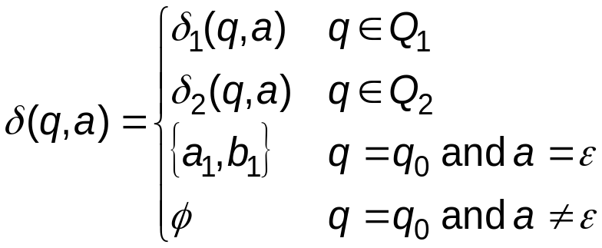
Closure Under Regular Operations
Let,
  N₁ = (Q₁, Σ, δ₁, a₁, F₁) recognizes A₁.
  N₂ = (Q₂, Σ, δ₂, b₁, F₂) recognizes A₂.
UNION: Construct N = (Q, Σ, δ, q₀, F) to recognize A₁∪ A₂.
  Q = {q₀} ∪ Q₁ ∪ Q₂.
  q₀ is the starting state.
  F = F₁ ∪ F₂.
  For any q ∈Q and a ∈Σ_{ε},
N₁
N₂
a₁
b₁
N

q₀

a₁
b₁
CSC3113 – Theory Of Computation
Mashiour Rahman
DFA & NFA →<number>

Slide 13
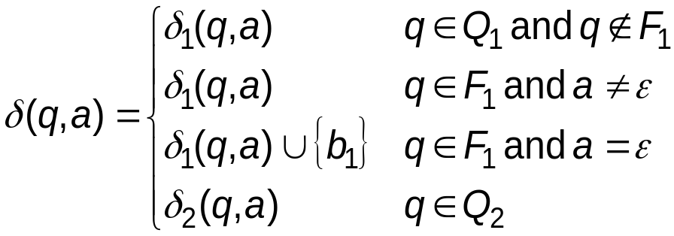
Closure Under Regular Operations
Let,
  N₁ = (Q₁, Σ, δ₁, a₁, F₁) recognizes A₁.
  N₂ = (Q₂, Σ, δ₂, b₁, F₂) recognizes A₂.
CONCATENATION: Construct N = (Q, Σ, δ, q₀, F) to recognize A₁° A₂.
  Q = Q₁ ∪ Q₂.
  q₀ = a₁.
  F = F₂.
  For any q ∈Q and a ∈Σ_{ε},
N₁
N₂
a₁
b₁
N

b₁
a₁

CSC3113 – Theory Of Computation
Mashiour Rahman
DFA & NFA →<number>

Slide 14
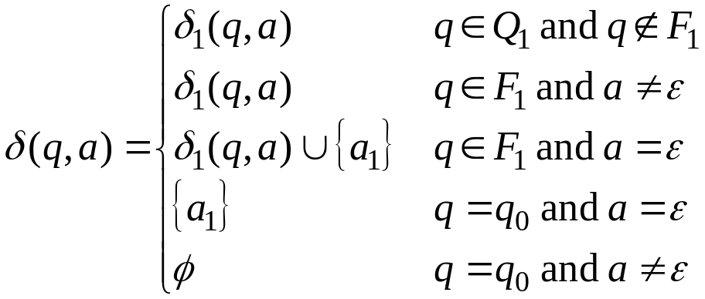
Closure Under Regular Operations
Let,
  N₁ = (Q₁, Σ, δ₁, a₁, F₁) recognizes A₁*.
STAR: Construct N = (Q, Σ, δ, q₀, F) to recognize A₁*.
  Q = {q₀} ∪ Q₁.
  q₀ is the new start state.
  F = {q₀} ∪ F₁.
  For any q ∈Q and a ∈Σ_{ε},
N₁
a₁
N
q₀

a₁


CSC3113 – Theory Of Computation
Mashiour Rahman
DFA & NFA →<number>

